Slide 1
Kubernetes in Action
Appendix
2025.01.28

Slide 2
Building Multi-Node Cluster

Slide 3
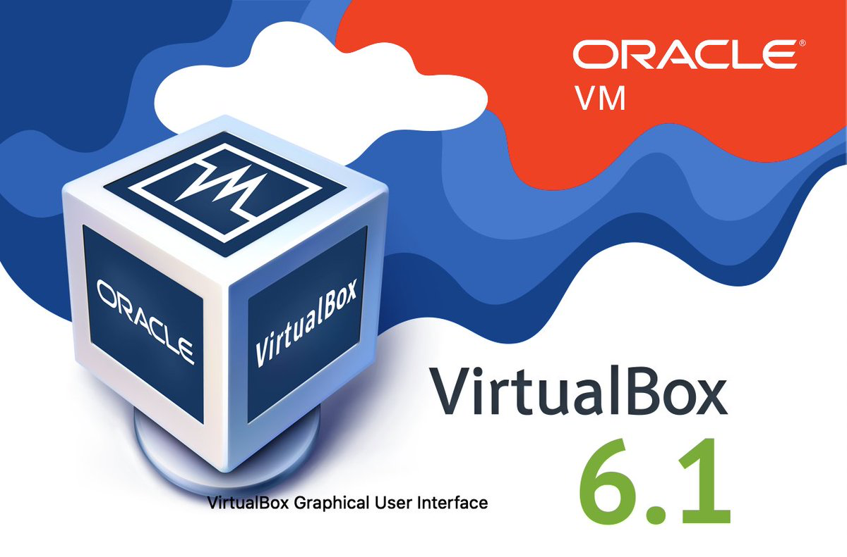
Operating System Requirements
VirtualBox :
  First, you need to download and install VirtualBox, if you don’t have it installed already. You can download it from https://www.virtualbox.org/wiki/Downloads.
  Once you have it running, download the Ubuntu 20.04 or Ubuntu 22.04(2023.04) ISO image from https://ubuntu.com/download/desktop/thank-you?version=22.04.2&architecture=amd64. You can also use a different Linux distribution, but make sure it’s supported by checking the https://kubernetes.io/docs/tasks/tools/ website.
  NOTE : For Apple M1, VirtualBox technical preview version is available now(2023.04). VMWare 7.x Beta version is also available.

Slide 4
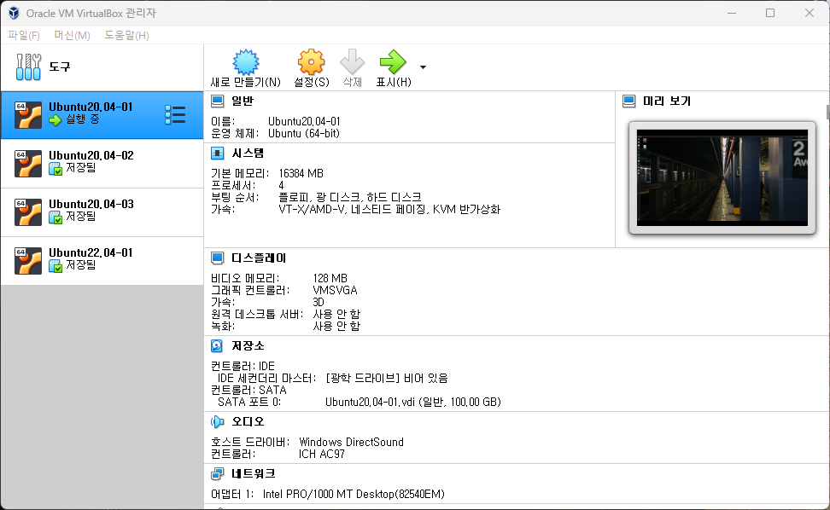
Creating Virtual Machine
Virtual Machine Setting :
  Next, you’ll create the VM for your Kubernetes master. Start by clicking the New icon in the upper-left corner. Then enter “VirtualBox Image Name” as the name, and select Linux as the Type and 64-bit.
  After clicking the Next button, you can set the VM’s memory size and set up the hard disk. If you have enough memory, select at least 2GB (keep in mind you’ll run three such VMs, 16GB is preferrable, 4 CPU : 2 Physical, 2 Hyper Thread in each CPU). When creating the hard disk, leave the default options selected(But, 100GB is preferrable).
  Here’s what they were in my case :
    Hard disk file type: VDI (VirtualBox Disk Image)
    Storage on physical hard disk : Dynamically allocated
    File system size: Ubuntu20.04-01, Ubuntu20.04-02, Ubuntu20.04-03, etc., size 100GB SSD

Slide 5
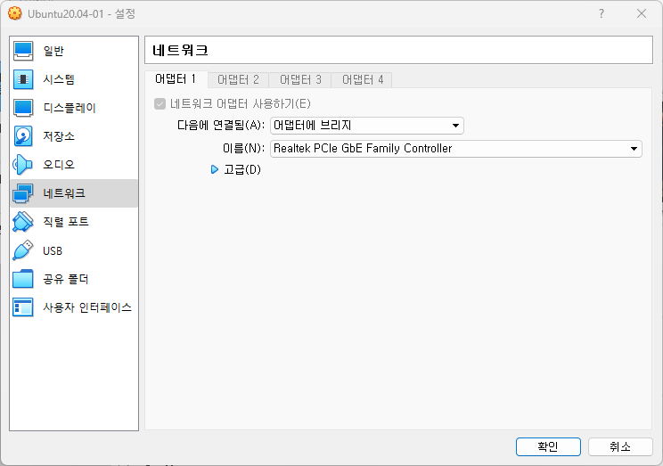
Configuring the Network Adapter for the VM
Adapter Bridge :
  Once you’re done creating the VM, you need to configure its network adapter, because the default won’t allow you to run multiple nodes properly. You’ll configure the adapter so it uses the “Bridged Adapter” mode. This will connect your VMs to the same network your host computer is in. Each VM will get its own IP address, the same way as if it were a physical machine connected to the same switch your host computer is connected to. Other options are much more complicated, because they usually require two network adapters to be set up.
  To configure the network adapter, make sure the VM is selected in the main VirtualBox window and then click the Settings icon (next to the New icon you clicked before).
  A window like the one shown in the following figure will appear. On the left-hand side, select Network and then, in the main panel on the right, select “Attached to: Bridged Adapter”, as shown in the figure. In the Name drop-down menu, select your host machine’s adapter, which you use to connect your machine to the network.

Slide 6
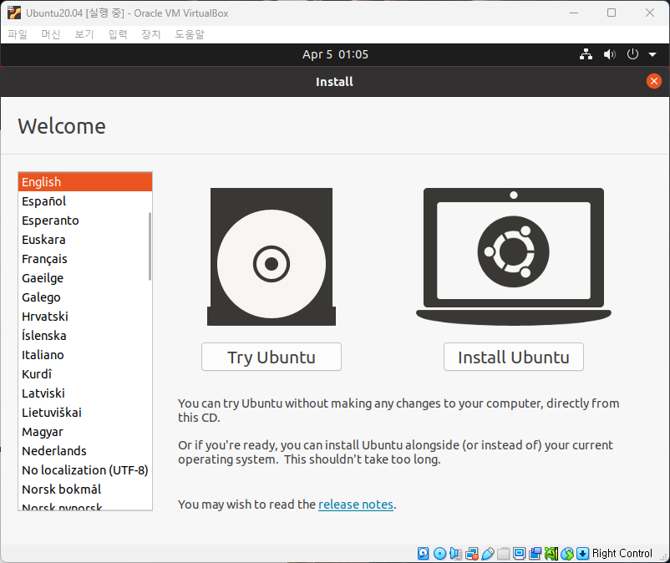
Installing the Operating System
Setting up Operating System :
  You’re now ready to run the VM and install the operating system. Ensure the VM is still selected in the list and click on the Start icon at the top of the VirtualBox main window.
  NOTICE : Sometimes, when you try to install Ubuntu 2x.04 version on VirtualBox with “Adapter Bridge” networking mode, VM will crash. In this case, change the networking mode to “NAT”. Then try again. After the installation of the OS, you can chance the “NAT” to “Adapter Bridge” networking mode.

Slide 7
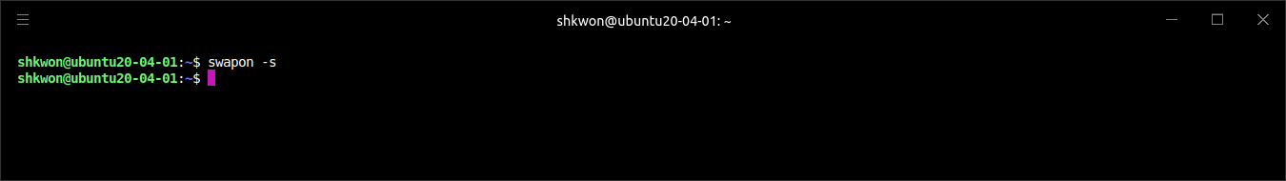
Installing Docker and Kubernetes
Docker, Kubelet, Kubeadm, Kubectl :
  Please refer to https://docs.docker.com/engine/install/ubuntu/ for Docker installation on Ubuntu.
  NOTICE : Don’t forget the “Post-Installation” on Ubuntu.
  To install Kubernetes, please refer to https://kubernetes.io/docs/setup/production-environment/tools/kubeadm/install-kubeadm/#installing-kubeadm-kubelet-and-kubectl.
  NOTICE : You need to disable “Swapping” in order for the Kubelet to work properly.
  NOTE : After the swapping off, you can not see anything when you enter “swapon –s” command in the console.

Slide 8
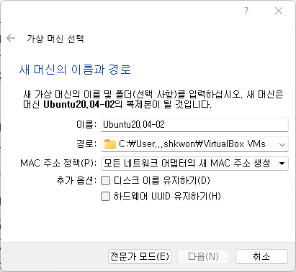
Clone the VM
Copying Virtual Machine :
  To clone(copy and paste?) your VM, shutdown the VM first with “$ shutdown now” command.
  Now, right-click on the VM in the VirtualBox UI and select “Clone”. Enter the name for the new machine as shown in the following figure. Make sure you check the “Reinitialize the MAC address of all network cards option”, so each VM uses different MAC addresses (because they’re going to be located in the same network).
  After the cloning, you need to “change the hostname” in Ubuntu setting menu.

Slide 9
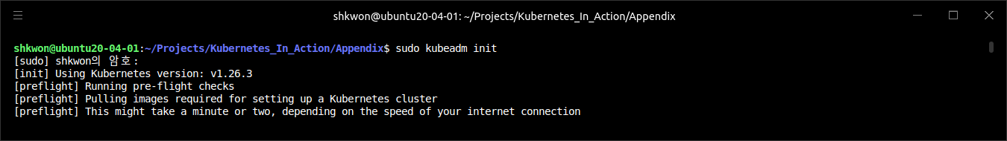
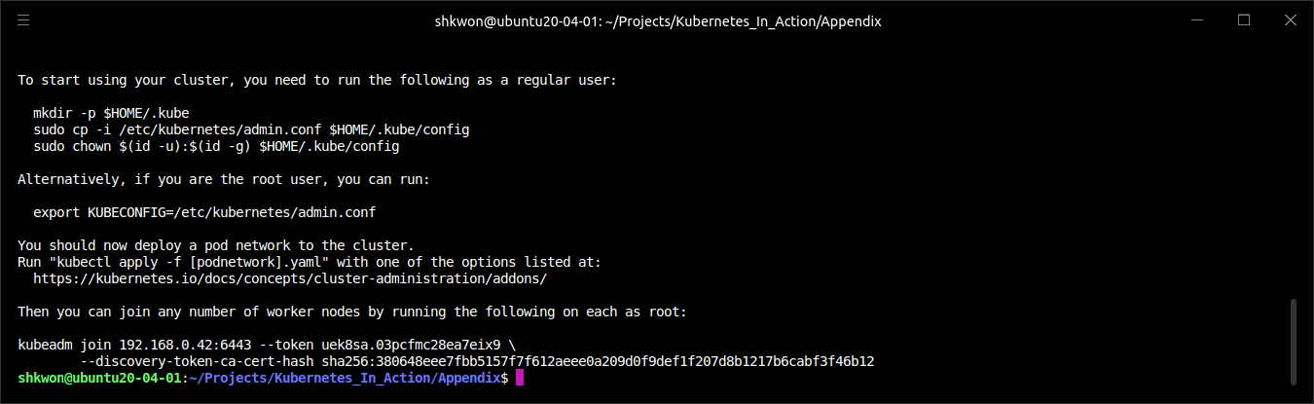
Configuring the Master with Kubeadm(1/2)
Initializing Kubeadm :
  You’re now ready to finally set up the “Kubernetes Control Plane” on your master node. Thanks to the awesome “kubeadm” tool, all you need to do to initialize the master is run a single command, “$ kubeadm init”.

Slide 10
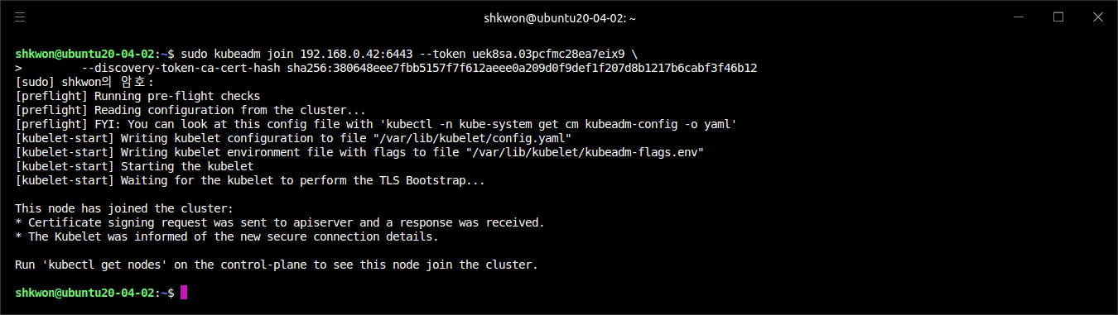
Configuring the Master with Kubeadm(2/2)
Initializing Kubeadm :
  Kubeadm has deployed all the necessary “Control Plane” components, including etcd, the API server, Scheduler, and Controller Manager. It has also deployed the kube-proxy, making Kubernetes services available from the master node.
  NOTE : Write down the command shown in the last line from the kubeadm init’s output of the previous screenshot. You’ll need it later.
  Run the following command in the worker nodes.
$ sudo kubeadm join 192.168.0.42:6443 --token uek8sa.03pcfmc28ea7eix9 \
--discovery-token-ca-cert-hash sha256:380648eee7fbb5157f7f612aeee0a209d0f9def1f207d8b1217b6cabf3f46b12

Slide 11
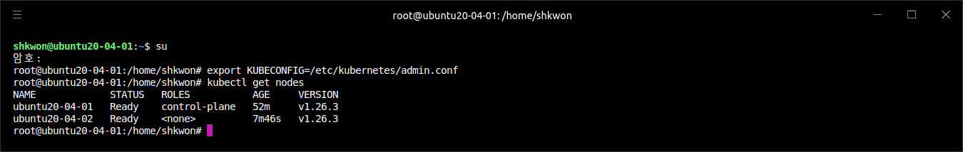
Understanding How Kubeadm Runs the Components(1/3)
Running Kubectl on the Master Node :
  All the components are running as containers. You can use the “$ docker ps” command to confirm this. But kubeadm doesn’t use Docker directly to run them. It deploys their YAML descriptors to the “/etc/kubernetes/manifests” directory. This directory is monitored by the “Kubelet”, which then runs these components through Docker. The components run as Pods. You can see them with the “$ kubectl get” command. But first, you need to configure “kubectl”.
  You installed “kubectl” along with “docker”, “kubeadm”, and other packages(like “kubelet”) in one of the initial steps. But you can’t use “kubectl” to talk to your cluster without first configuring it through a “kubeconfig” file.
  Luckily, the necessary configuration is stored in the “/etc/kubernetes/admin.conf” file. All you need to do is make kubectl use it by setting the “KUBECONFIG” environment variable :
$ export KUBECONFIG=/etc/kubernetes/admin.conf

Slide 12
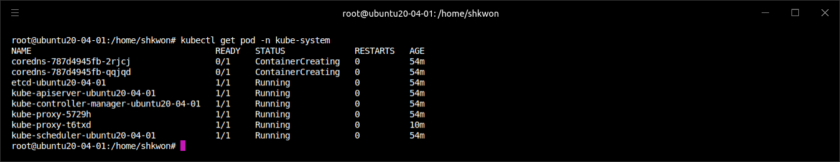
Understanding How Kubeadm Runs the Components(2/3)
Listing The Pods :
  To test kubectl, you can list the pods of the Control Plane (they’re in the “kube-system” namespace), as shown in the following listing.
$ kubectl get pod -n kube-system

Slide 13
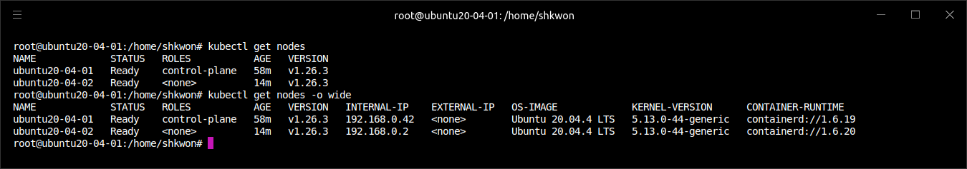
Understanding How Kubeadm Runs the Components(3/3)
Listing Nodes :
  You’re finished with setting up the master, but you still need to set up the nodes. Although you already installed the Kubelet on both of your two worker nodes (you either installed each node separately or cloned the initial VM after you installed all the required packages), they aren’t part of your Kubernetes cluster yet. You can see that by listing nodes with kubectl :
$ kubectl get node

Slide 14
Configuring Worker Nodes with Kubeadm(1/4)
Setting up Worker Nodes :
  When using kubeadm, configuring worker nodes is even easier than configuring the master. In fact, when you ran the kubeadm init command to set up your master, it already told you how to configure your worker nodes (repeated in the next listing).
  All you need to do is run the “$ kubeadm join” command with the specified token and the master’s IP address/port on both of your nodes. It then takes less than a minute for the nodes to register themselves with the master. You can confirm they’re registered by running the “$ kubectl get node” command on the master again :
$ sudo kubeadm join 192.168.0.42:6443 --token uek8sa.03pcfmc28ea7eix9 \
--discovery-token-ca-cert-hash sha256:380648eee7fbb5157f7f612aeee0a209d0f9def1f207d8b1217b6cabf3f46b12

Slide 15
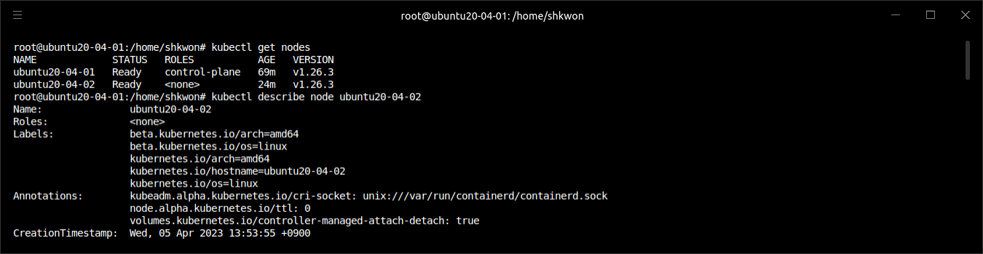
Configuring Worker Nodes with Kubeadm(2/4)
Investigating Nodes :
  Let’s use the “$ kubectl describe” command in the following listing to see more information. Somewhere at the top, you’ll see a list of Conditions, showing the current conditions on the node. One of them will show the following Reason and Message.
$ kubectl describe node ubuntu20-04-02

Slide 16
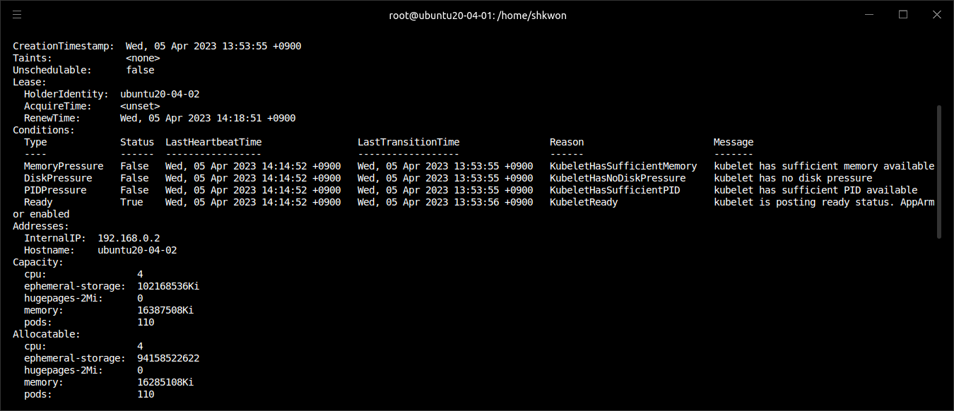
Configuring Worker Nodes with Kubeadm(3/4)
Investigating Nodes :
  As you can see from the following screenshot, the worker node(here it is “ubuntu20-04-02”.) is ready to work.

Slide 17
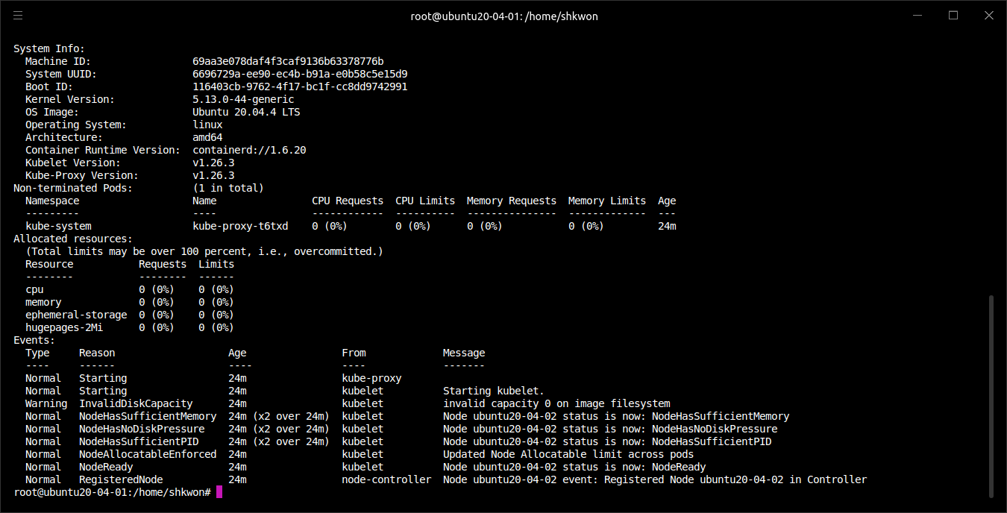
Configuring Worker Nodes with Kubeadm(4/4)
Investigating Nodes :

Slide 18
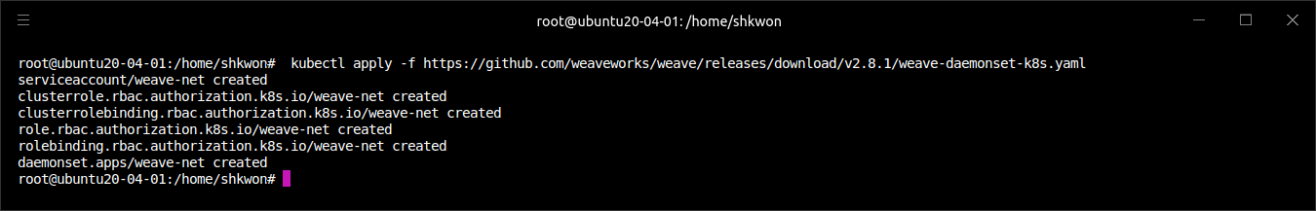
Setting up the Container Network(1/2)
Installing Networking Plugin :
  You’ll install the “Weave Net container networking plugin”, but several alternatives are also available. They’re listed among the available Kubernetes add-ons at https://kubernetes.io/docs/concepts/cluster-administration/addons/.
  To see how to deploy the Weave Net plugin (like most other add-ons), please refer to https://www.weave.works/docs/net/latest/kubernetes/kube-addon/ :
  NOTE : This will deploy a “DaemonSet” and a few security-related resources.
kubectl apply -f https://github.com/weaveworks/weave/releases/download/v2.8.1/weave-daemonset-k8s.yaml

Slide 19
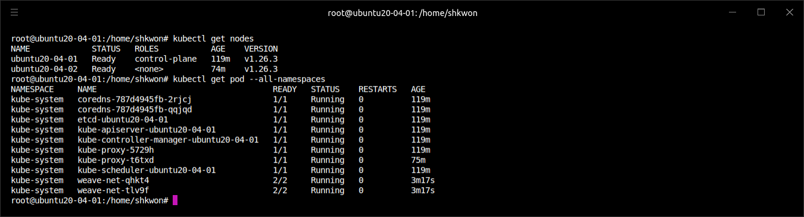
Setting up the Container Network(2/2)
Installing Networking Plugin :
  Once the “DaemonSet” controller creates the pods and they’re started on all your nodes, the nodes should become ready.
  You now have a fully functioning multi-node Kubernetes cluster with an overlay network provided by “Weave Net”. All the required components, except for the Kubelet itself, are running as pods, managed by the Kubelet, as shown in the following listing.

Slide 20
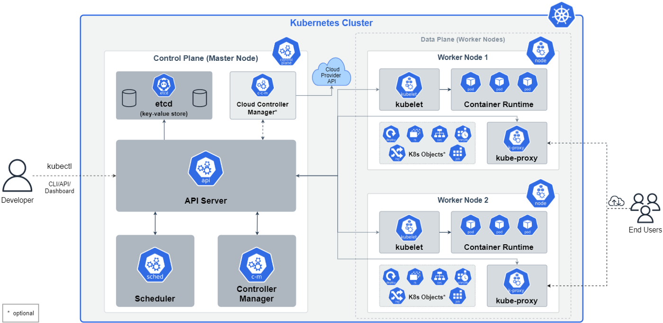
NOTE : Big Picture - The Kubernetes Cluster

Slide 21
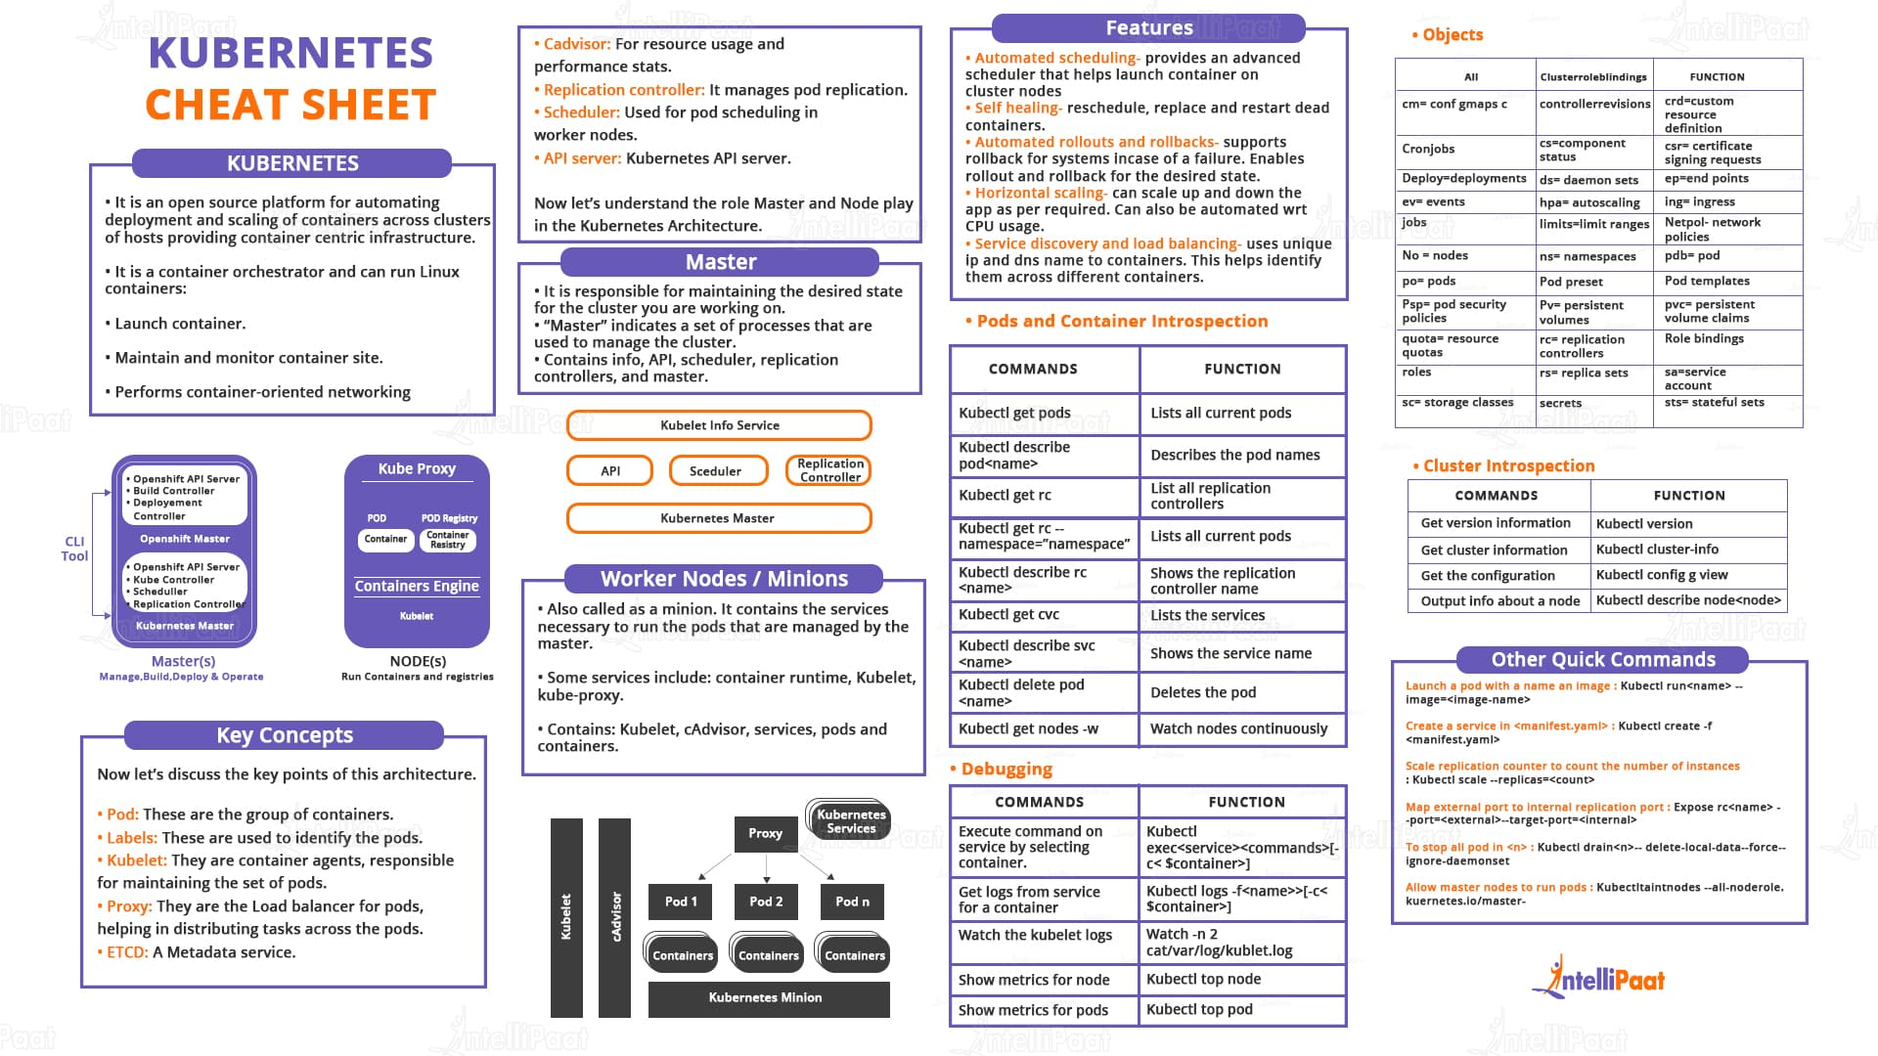
NOTE : Kubernetes Cheat Sheet

Slide 22

Reference
[1] Kubernetes in Action, Marko Luksa, Manning, 2018 1st Edition.
[2] https://github.com/luksa/kubernetes-in-action
[3] https://minikube.sigs.k8s.io/docs/
[4] https://kubernetes.io/docs/reference/kubectl/cheatsheet/

Slide 23

? & !

